Slide 1

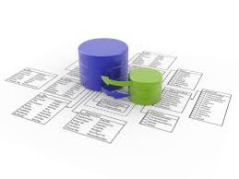


Mobile Applications for iPhone and iPad
Course Program, Evaluation, Examination
Mobile Applications for iPhone and iPad
Telerik Software Academy
http://academy.telerik.com

Slide 2

Table of Contents
Mobile Applications for iPhone and iPad course
The Trainers Team
Exams and Evaluation
Standard Criteria
Bonuses
Resources for the Course

Slide 3

Mobile Applications for iPhone and iPad Course Program
Topics and stuff

Slide 4
Mobile Applications for iPhone and iPad Course Program
Couse Introduction
Introduction to Programming with Objective C and Xcode
Memory Management
iOS Hello World Application
iOS App Architecture
Views and controls
Storyboards, UI, Transitions and Controls
MVC in iOS App

Slide 5
Mobile Applications for iPhone and iPad Course Program
App lifecycle
Custom Views
Animations
Notifications
Working HTTP
Core Data
Address book API
Geolocation API
Camera API

Slide 6
Mobile Applications for iPhone and iPad Course Program
User settings
Async execution in iOS apps
Gestures
App config
Workshop: Developing an iOS application
Project consultation
Project consultation
Project defense

Slide 7
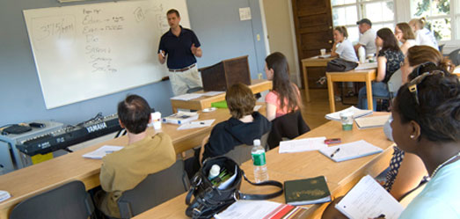
The Trainers Team

Slide 8
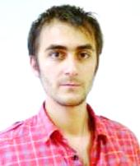
Trainers Team
Doncho Minkov
Senior Technical Trainer @ Telerik Software Academy
Contestant in the Informatics competitions
Experience with Web and Mobile apps
Proficient with JavaScript and .NET
Champion from Telerik Software Academy
Email: doncho.minkov [at] telerik.com
Blog: http://minkov.it

Slide 9





Evaluation
Thank God There Are Bonuses!

Slide 10

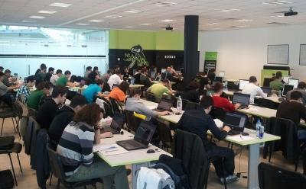
iOS Apps : Evaluation
Evaluation components
Course project – 75%
Homework – 10%
Homework evaluation – 5%
3 peer reviews per homework (excellent, OK, bad)
Attendance in class – 10%
Bonuses
Forums activity – bonus up to 5%

Slide 11


Pass / Excellence / Fail Criteria
Criteria for pass / pass with excellence / fail
Pass with excellence
Very high exam results
or
High total results
Pass
Average total results
Fail
Low total results or low exam results

Slide 12
Homework Peer Reviews
Everyone will get feedback for their homework
Everyone will give feedback for few random homework submissions
Students submit homework anonymously
Please exclude your name from the submissions!
For each homework submitted
Students evaluate 3 random homeworks
From the same topic, after the deadline
Homework comments are not obligatory

Slide 13
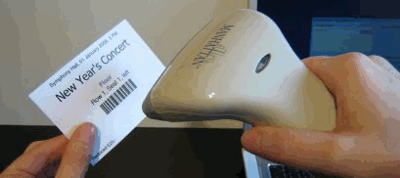
Check Your Presence
From now on you should check your presence on the barcode reader 2-3 times a day:
In the morning when lectures begin (~10:30)
After lunch break (~13:30)
When you have data structures and algorithms when the lecture starts (~18:00)

Slide 14
Course Project
The course project will consist of developing an mobile application for iPhone & iPad
In random teams of two
Should work with remote data (REST)
Should use device capabilities
And more
More details later today

Slide 15








Resources
What We Need in Addition to this Course Content?

Slide 16
Course Web Site & Forums
Register for the "Telerik Academy Forums":
Discuss the course exercises with your colleagues
Find solutions for the exercises
Share source code / discuss ideas
The mobile apps for iPhone and iPad official web site:
http://forums.academy.telerik.com/mobile-development/iOS-Mobile-Apps
academy.telerik.com/student-courses/software-technologies/iphone-and-ipad-mobile-apps

Slide 17
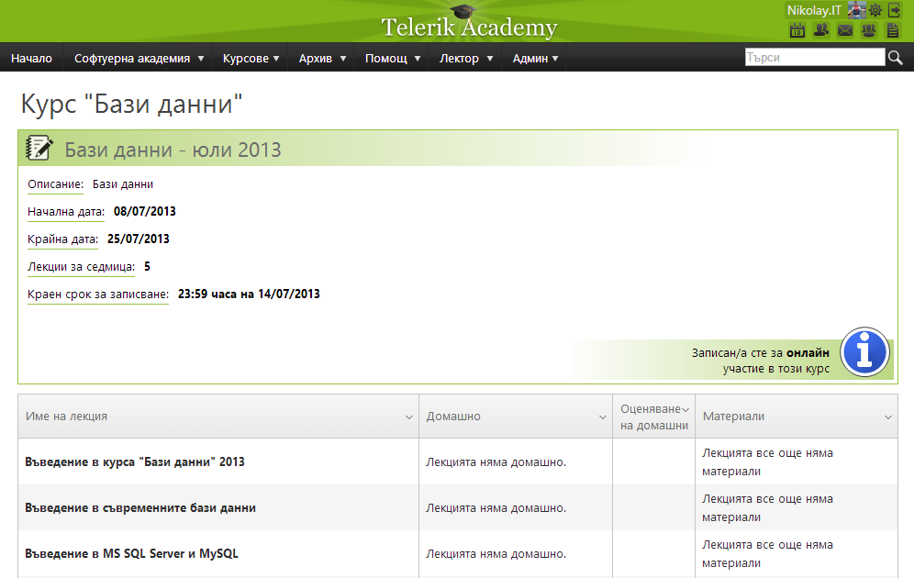
Telerik Integrated Learning System (TILS)
The Telerik Integrated Learning System (TILS)
www.telerikacademy.com
Important resource for all students
Homework submissions
Homework peer reviews
Presence cards with barcode
Reports about your results
telerikacademy.com/Courses/Courses/Details/198

Slide 18
Required Software
Software needed for this course:
MAC OS X OS
At least MAC OS X 10.8 Mavericks
Xcode IDE
Tools for working with git and GitHub

Slide 19





Mobile apps for iPhone & iPad
http://academy.telerik.com

Slide 20




Free Trainings @ Telerik Academy
C# Programming @ Telerik Academy
csharpfundamentals.telerik.com
Telerik Software Academy
academy.telerik.com
Telerik Academy @ Facebook
facebook.com/TelerikAcademy
Telerik Software Academy Forums
forums.academy.telerik.com

